Slide 2

Deep U-tube heat exchanger breakthrough:
combining laser and cryogenic gas
for geothermal energy exploitation
E. Di Sipio¹, A. Manzella², R. Pasquali³, L. Pockéle⁴, A. Romanowski⁵, O. Steinmeier⁶
¹Dep. of Geosciences, University of Padova, Via Giovanni Gradenigo 6, 35131 Padova, Italy
²Istituto di Geoscienze e Georisorse, National Research Council (CNR), Area CNR, Via G. Moruzzi 1 56124 - Pisa, Italy
³TERRA GEOSERV LIMITED, Unit 6 Block B Southern Cross Business Park Boghal, Bray, Ireland
⁴R.E.D. SRL, Viale dell'Industria 58E, 35129 Padova, Italy
⁵PREVENT GMBH, Fitzplei 4, 41748 Viersen, Germany
⁶Fraunhofer IAPT, Am Schleusengraben 14, 21029 Hamburg, Germany
info@deepu.eu

Slide 3
CONTENTS
01
03
THE DeepU PROJECT CONCEPT
LABORATORY TESTS
02
04
THE DeepU PROJECT OBJECTIVES
MARKET ANALYSIS FOR A SUSTAINABLE DEPLOYMENT

Slide 4
PART 01
THE DeepU PROJECT CONCEPT

Slide 5
THE DeepU PROJECT CONCEPT
Optimising access to deep geothermal resources with new state-of-the-art drilling technologies to unleash clean, abundant energy from the Earth
GOALS
Geothermal energy accessible anywhere
Extract energy from deep (>4 km) U-shaped closed-loop geothermal heat exchangers (HE)
Reduce the costs of well drilling and provide HE immediately developed after drilling

Slide 6
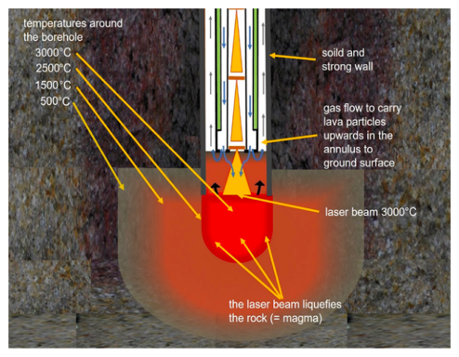
INNOVATIVE DRILLING TECHNOLOGY
A laser propulsion drilling method is combined with cryogenic gaseous flushing for cooling the laser drill head.
Improved ROP
Reduced drilling time and cost
In case a glazed layer is formed on the borehole walls, the obtained systems are physically isolated from the surrounding formations and immediately developed after drilling without requiring further casing activities.
Reduced drilling time and cost for setting up
the heat exchanger (HE)

Slide 7
PART 02
THE DeepU PROJECT OBJECTIVES

Slide 8
THE DeepU PROJECT OBJECTIVES
Develop and calibrate the drilling technology by:
  selecting a cryogenic gas able to cool in a controlled manner the rock melted by a laser;
  developing an innovative lightweight drill string able to host the gas and the laser at the same time;
  developing specific temperature control analysis and innovative laser lenses able to convey the heat and to sustain multilateral drilling;
Determine the physical-thermal phenomena affecting different kinds of rocks to assess the borehole wall vitrification and integrity;
Evaluate the legislative aspects and environmental standards related to the innovation proposed;
Define the DeepU geothermal exploitation potential, including economic analyses, based on case studies modelling.

Slide 9
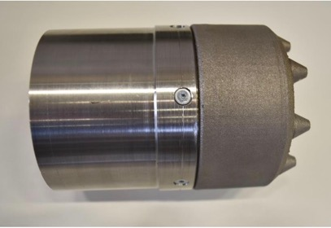
A NOVEL PROCESSING HEAD FOR LASER DRILLING
With the help of the processing head, the cryogenic gas stream is directed onto the rock, which is melted by a high-power laser beam.
The first operational prototype consists of the titanium alloy Ti-6Al-4V in order to meet the requirements for the component in terms of mechanical strength and temperature resistance.
It has been 3D printed for rapid prototyping and to simplify printing the gas channels directly into the component.

Slide 10
PART 03
LABORATORY TESTS

Slide 11
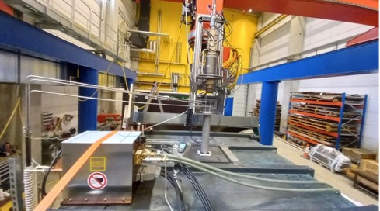
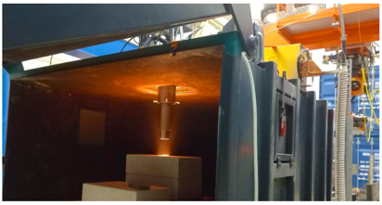
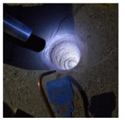
LABORATORY TESTS
A lab for experimental development and testing of the new laser drilling process
The technical equipment includes
a high-power laser system
processing optics
a drill string with the special 3D printed drill head
a gas feeding system, with which the process gas can be tempered
The drill string is mounted on a robot
The process application takes place inside a press container, which acts as a safety enclosure
Constant ROPs upwards of 20m/hr have been achieved, with relatively low energy inputs and no component wear.

Slide 12
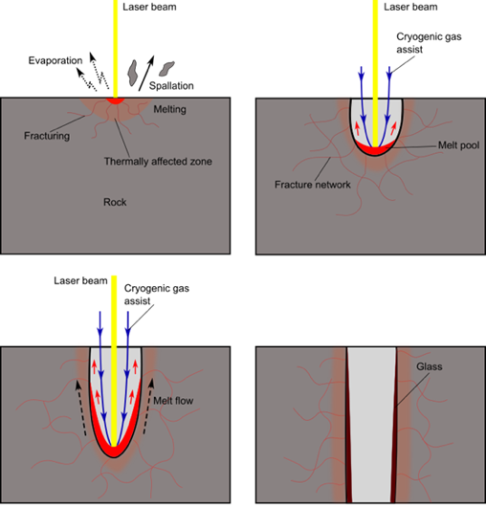
CHARACTERIZATION OF THE ROCK SAMPLES
The petro-thermo-mechanical phenomena affecting different rocks are being analysed, also to assess the borehole wall vitrification and integrity.

Slide 13
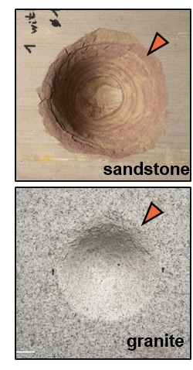
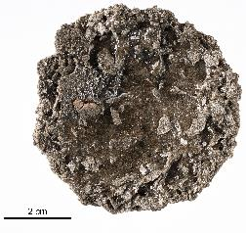
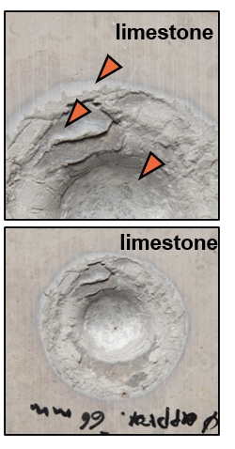
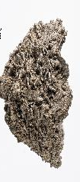
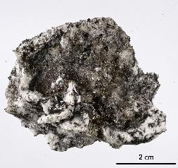
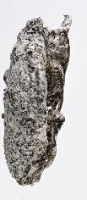
CHARACTERIZATION OF THE ROCK SAMPLES
The petro-thermo-mechanical phenomena affecting different rocks are being analysed, also to assess the borehole wall vitrification and integrity.
glass
glass

Slide 14
PART 04
MARKET ANALYSIS FOR A SUSTAINABLE DEPLOYMENT

Slide 15
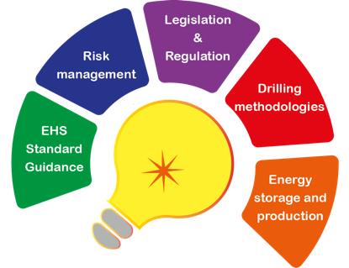
MARKET ANALYSIS FOR A SUSTAINABLE DEPLOYMENT
The project is analysing and assessing:
The exploitation potential
The economics of the developed drilling technology
The legislative aspects and environmental
Health and safety (EHS) standards related to the proposed solution.
The risks involved comparing DeepU technology to conventional deep drilling

Slide 16

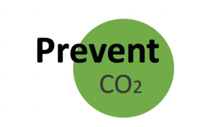



THE PROJECT TEAM
This research is funded by the European Union (G.A. 101046937). However, the views and opinions expressed are those of the author(s) only and do not necessarily reflect those of the European Union or EISMEA. Neither the European Union nor the granting authority can be held responsible for them.
www.deepu.eu

Slide 17
Thank you for your attention

